Slide 1
The Texas A&M University System
Introductory Civil Rights
Investigator Training
    System Ethics and Compliance Office
    January 2021
    Presented via Webex

Slide 2
Civil Rights Investigator Training
The Training Team
  Trisha Ford – Investigator, SECO
  Janet Gordon – System Ethics and Compliance Officer
  Rick Olshak, M.S. – Director, Title IX Compliance, SECO
  Noe Rincones – Investigator, SECO
  Dr. Nicole Roberson– Director, Equal Opportunity and Diversity, SECO
We also wish to acknowledge the contributions of Bret Davis (formerly of OGC) and Dr. Joni Baker (Texas A&M University – San Antonio, formerly with SECO) in developing these training materials.
Notes:
Modifier order fixed…changes in ALL CAPS

Slide 3
Civil Rights Investigator Training
Section One
Introduction to the
Training Program
Notes:
Modifier order fixed…changes in ALL CAPS

Slide 4
Civil Rights Investigator Training
Introduction (overview)
  Program designed for investigators for all civil rights and ethics investigations
  Serves as a “baseline” training curriculum (as well as a refresher training) – assumes no previous knowledge and/or experience
  Intended to be complemented by “deeper dive” training programs in specific areas of investigation
  We will focus on specific areas of practice and skill, and see a case study through from its initial report to a final conclusion
Notes:
Modifier order fixed…changes in ALL CAPS

Slide 5
Civil Rights Investigator Training
Introduction (mechanics)
  You will all be assigned to work groups for the entirety of the training program – please work with other members of your group for all exercises and activities
  It is important to be engaged – please minimize any distractions such as cell phones, email, internet, etc. (except in cases of emergencies)
  We want this to be an interactive program and encourage questions and comments; we will balance that against a need to cover all of the material in the time provided
Notes:
Modifier order fixed…changes in ALL CAPS

Slide 6
Civil Rights Investigator Training
Introduction (mechanics)
  We will use the time that we need to cover the topic areas we intend to cover in each session – we intend to begin on time and will not keep you longer than is needed.
  In the event that we cannot address a specific question or topic, or if you choose to wait on a question, please maintain a personal “parking lot” of issues you would like addressed – we will endeavor to address all parking lot items in our time together
Notes:
Modifier order fixed…changes in ALL CAPS

Slide 7
Civil Rights Investigator Training
Introduction (mechanics)
  Our training will involve a case study that will evolve over the training. Each group will self-assign two investigators and two role players. All other members of the group will serve as observers, who also will play the roles of witnesses.
  We are adapting an in-person training to the Webex environment; as such, we are still learning how this program will “time out” over the training. We appreciate (in advance) your patience with us as we test and modify this program.
Notes:
Modifier order fixed…changes in ALL CAPS

Slide 8
Civil Rights Investigator Training
Introduction (disclaimers)
  While we have adapted System Regulation 08.01.01 to the new federal regulations on Title IX, we are of course now waiting for the Biden Administration to issue new directives regarding civil rights enforcement once they take office on January 20. We will make you aware of information and how it effects our practices as it becomes available.
Notes:
Modifier order fixed…changes in ALL CAPS

Slide 9
Civil Rights Investigator Training
Introduction (triggers)
  Please know that we will use strong/explicit language that is appropriate to situations as they would be described by the parties
  Please know that our subject matter will include issues that some of our participants may find to be disturbing and/or personally triggering
Notes:
Modifier order fixed…changes in ALL CAPS

Slide 10
Civil Rights Investigator Training
Introduction (materials)
  This material is intended solely for this training environment, and cannot be used for commercial purposes; if you need presentation resources please contact SECO
Notes:
Modifier order fixed…changes in ALL CAPS

Slide 11
Civil Rights Investigator Training
Today’s Agenda:
  Group Assignments and initial activity
  Investigations Process and Logistics
  Introduction of the Case Study
Notes:
Modifier order fixed…changes in ALL CAPS

Slide 12
Civil Rights Investigator Training
Introduction (group assignments)
  Please note that we will be taking time early on to establish breakout groups that we will be working with throughout the training. Please be patient with us until we get our groups set up.
Notes:
Modifier order fixed…changes in ALL CAPS

Slide 13
Civil Rights Investigator Training
Introduction (group assignments)
  Please introduce yourself with:
    Name (and preferred name)
    Institution and Position
    Past experience as an investigator
    What you hope to get from this training program
  Come back to the main room in 15 minutes
Notes:
Modifier order fixed…changes in ALL CAPS

Slide 14
Civil Rights Investigator Training
Agenda (topic areas)
  Investigations Process and Logistics
  Conducting Interviews
  Analyzing Information
  Developing a Report
  Case Study (note that the case study will be introduced early in the training and sections of the case study will be completed across our two days together)
Notes:
Modifier order fixed…changes in ALL CAPS

Slide 15
Civil Rights Investigator Training
Section Two
The Investigations Process
and Logistics
Notes:
Modifier order fixed…changes in ALL CAPS

Slide 16
Civil Rights Investigator Training
Investigations Process & Logistics
a. Role of the Investigator
b. Key Stages of Process
c. Assignment of Investigators
d. Initial Planning
e. Developing a Strategy
f. Logistics
Notes:
Modifier order fixed…changes in ALL CAPS

Slide 17
Civil Rights Investigator Training
Role of the Investigator
Is to be:
- Thorough
- Reliable
- Prompt
- Fair
Notes:
Modifier order fixed…changes in ALL CAPS

Slide 18
Civil Rights Investigator Training
Mindset of the Investigator
As the Collector of Information (Facts, Perceptions, Assumptions, Lies)
-both Inculpatory and Exculpatory (favorable/unfavorable)
-Inculpatory would reflect a person’s involvement in an alleged act of misconduct
-Exculpatory would tend to exonerate a person of misconduct
Notes:
Modifier order fixed…changes in ALL CAPS

Slide 19
Civil Rights Investigator Training
Mindset of the Investigator
- deferential to the facts; no “sides”
- detached, objective, and neutral (as possible)
- understand the full context of the event or series of events
- determine whether there are additional relevant facts
Q – When should you write the conclusion?
Notes:
Modifier order fixed…changes in ALL CAPS

Slide 20
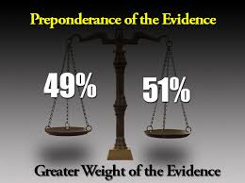
Civil Rights Investigator Training
Role of the Investigator
Collect the Facts; Don’t allow your potential bias/pre-conceived ideas to influence any part of the process.
Notes:
Modifier order fixed…changes in ALL CAPS

Slide 21
Civil Rights Investigator Training
Key Stages of the Process
Where does the investigation fit in to the process?
Notice
Preliminary Inquiry (conducted by assigner of investigators)
Full (formal) Investigation (conducted by investigators)
Collecting and Evaluating the Facts/Writing the Report (done by investigators)
OGC/SECO Review/Designated Administrator
Findings
Sanction
Appeal
Notes:
Modifier order fixed…changes in ALL CAPS

Slide 22
Civil Rights Investigator Training
Key Stages of the Process
Preliminary Inquiry Stage
- Are we on “notice”?
- Are there “enough” alleged Facts/Witnesses?
- What type of matter: 08.01.01/Ethics/Other misconduct?
- What are the status of the Parties (employee/student/third party)?
- When did the 30 business days Clock start?
- Who assigns investigators?
- Who grants extensions?
Notes:
Modifier order fixed…changes in ALL CAPS

Slide 23
Civil Rights Investigator Training
Key Stages of the Process
Preliminary Inquiry Stage
- Confidentiality Issues:
Confidentiality v. Privacy
- ”Need to Know”
- Pseudonym
- hidden for the investigation & report / key provided separately
- if name not known – then Due Process?
- Law Enforcement “Pseudonym Program”
Notes:
Modifier order fixed…changes in ALL CAPS

Slide 24
Civil Rights Investigator Training
Key Stages of the Process
Preliminary Inquiry Stage
- Little “i” inquiry (Pre-Investigative Stage)
-sometimes…things happen
- document, document, document
- watch out for “insignificant” evidence
-REMEMBER – we are Collectors and Reporters of Information
Notes:
Modifier order fixed…changes in ALL CAPS

Slide 25
Civil Rights Investigator Training
Key Stages of the Process
Assignment of the Investigator(s)
- Co-Investigators?
- Full or Part-time?
- Employment status (faculty/staff)
- Identities (e.g., Greek life, athletics, faculty;
demographics)
- Preferences and strengths
- Nature of the case
- Distribution of work
Notes:
Modifier order fixed…changes in ALL CAPS

Slide 26
Civil Rights Investigator Training
Key Stages of the Process
Assignment of the Investigator(s)
- Type of Case (e.g., sexual assault or harassment, student/employee discrimination, etc.)
- Experience
- Lead or 2nd Chair
- Style…
Notes:
Modifier order fixed…changes in ALL CAPS

Slide 27
Civil Rights Investigator Training
Key Stages of the Process
Formal Investigation Stage
Conclusions v Findings
  Report the full (material) facts
  Compare the facts to the allegation(s)
  Reach conclusions based on preponderance of the evidence standard
    Different for sex-based cases
Notes:
Modifier order fixed…changes in ALL CAPS

Slide 28
Civil Rights Investigator Training
Key Stages of the Process
OGC/SECO Review Stages
Thoroughness of the investigation
  All available evidence considered?
  Only relevant facts included
Sufficiency
  Facts properly analyzed?
  Conclusions supported by facts and analysis?
Notes:
Modifier order fixed…changes in ALL CAPS

Slide 29
Civil Rights Investigator Training
Key Stages of the Process
Decision/Hearing/Sanctioning Stage
“Designated Administrator”
  Administrator (AVP or lower recommended)
  Hearing panel
Findings/Decision
Sanctioning
  (education, restoration, protective, in addition to mandates – authority may be delegated and/or in form of recommendations)
Notes:
Modifier order fixed…changes in ALL CAPS

Slide 30
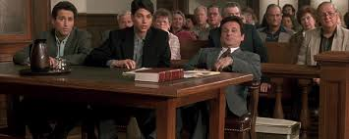
Civil Rights Investigator Training
Key Stages of the Process
Appeal Stage
Grounds
Regulations
Timeliness
Notes:
Modifier order fixed…changes in ALL CAPS

Slide 31
Civil Rights Investigator Training
Pre-Investigation Planning
- The investigator(s) should meet with the assigner of the investigation to review the scope and nature of the investigations process
Notes:
Modifier order fixed…changes in ALL CAPS

Slide 32
Civil Rights Investigator Training
Pre-Investigation Planning
Topics to Review:
- Fair and Equitable Process
- Allegation/Policy Violations
- Witnesses (Lists)
- Evidence identified
- What Key Witnesses/Evidence is missing
- Timeline/Flowchart of Events
- Record or Not to Record?
Notes:
Modifier order fixed…changes in ALL CAPS

Slide 33
Civil Rights Investigator Training
Pre-Investigation Planning
Matters of Inquiry:
- Use Common Sense; Walk away with an understanding
- Some Witnesses you may have to ask more Qs
- You MUST ask the $ Qs
Notes:
Modifier order fixed…changes in ALL CAPS

Slide 34
Civil Rights Investigator Training
Pre-Investigation Planning
Matters of Inquiry:
- Get Clarification:
- Not yes or no; unless trying box
- At the End:
- What else do you think might be important?
- Is there anything I should have asked that I did not?
- Anything you want me to ask the other Party?
Notes:
Modifier order fixed…changes in ALL CAPS

Slide 35
Civil Rights Investigator Training
Interview Logistics
- Determining location
- Determining order
- Initial greetings
- Opening Statement
- Concluding an interview
- Post-Interview follow-up
Notes:
Modifier order fixed…changes in ALL CAPS

Slide 36
Civil Rights Investigator Training
Interview Logistics
Location
- In person, video interviews, phone interviews, written Q&As
- Professional space (vs. personal space)
- Amount of traffic in area / type of traffic
- Out of view from other involved parties
- Timing of interviews
- Messages (intended and unintended) in the space
- Comfort
Notes:
Modifier order fixed…changes in ALL CAPS

Slide 37

Civil Rights Investigator Training
Interview Logistics
Consider
- Privacy and Safety
- What to wear (who are you interviewing?)
- Water, coffee, tissues, paper, pen, computer
- Seating strategy
- Virtual arrangements
- Timing (order and amount of time)
- Note-taking
- Accommodations?
Notes:
Modifier order fixed…changes in ALL CAPS

Slide 38
Civil Rights Investigator Training
Order of Interviews
Complainant – understand the allegations
Witnesses that can collaborate the allegations
Witnesses that would have material evidence (relevant to the allegation(s) – supporting or absolving)
Respondent – understand their perspective, as well as the dynamic and relationship
Witnesses that can corroborate the Respondent’s point of view
Additional Material Witnesses
Re-interviews as needed, particularly with Complainant and Respondent (typically narrowly focused interviews)
Notes:
Modifier order fixed…changes in ALL CAPS

Slide 39

Civil Rights Investigator Training
Interviews
Character Witnesses
  - Caution
Notes:
Modifier order fixed…changes in ALL CAPS

Slide 40
Civil Rights Investigator Training
Interview Logistics
Initial Greetings
- At door or in waiting area
- Introduce by first and last name and your role
- Ask them how you would like to address them
- Maintain open body language and make eye contact
- Establish rapport . Don’t launch immediately into questions, but get a sense of how they communicate by asking them to tell you a little about themselves, their major or employment function, as well as how long they have been at the university or agency.
Notes:
Modifier order fixed…changes in ALL CAPS

Slide 41
Civil Rights Investigator Training
Interview Logistics
Opening Statement
Should address:
- Who investigators are
- Describe the interview process
- Address note-taking/recording
- Address privacy
- Address retaliation
- Establish expectation of complete and truthful participation
- Address post-interview follow-up
- Invite questions at any time during the interview
Notes:
Modifier order fixed…changes in ALL CAPS

Slide 42

Civil Rights Investigator Training
Group Activity
Opening Statements
Notes:
Modifier order fixed…changes in ALL CAPS

Slide 43
Civil Rights Investigator Training
Group Activity
Take five (5) minutes privately to develop your own opening statement
We will ask three people to share their opening statements, and the panel will offer feedback
Make adjustments to your statement based on what you hear
Notes:
Modifier order fixed…changes in ALL CAPS

Slide 44
Civil Rights Investigator Training
Interview Logistics
Concluding an Interview
Should address:
- Question: Is there anything else that you believe is relevant that we should address?
- Question: Are there areas I should have asked you about but did not?
- Question: Are there other people that you believe I should speak with?
- Question: What else do you think might be important?
- Question: is there anything you want me to ask the other
party?
Notes:
Modifier order fixed…changes in ALL CAPS

Slide 45
Civil Rights Investigator Training
Interview Logistics
Concluding an Interview
Should address:
- Reiterate the key facts that were reported
- Reiterate privacy and retaliation considerations
- Invite them to contact you with additional information and provide contact information
- Address post-interview follow-up
- Question: Do you have any final questions for me?
- Thank them for their participation
Notes:
Modifier order fixed…changes in ALL CAPS

Slide 46
Civil Rights Investigator Training
Interview Logistics
Post-Interview Follow-up
- Provide each party an opportunity to review your summary of the interview (not your handwritten notes) and affirm that the information collected is accurate
- Provide 1-2 business days for the party to respond by email (may take a bit longer for faculty/administrators, time of year)
- When party challenges information in your summary, compare their comments to your own notes and recollections; only make changes in the summary/exhibit when you believe that their version is more accurate than your own
- If you disagree with a “correction,” include it as an additional exhibit and reference it if the statement is used in the report
Notes:
Modifier order fixed…changes in ALL CAPS

Slide 47
Civil Rights Investigator Training
Today’s Agenda:
  Case Study Prep – modification of process
  Conducting Interviews
  Culture
  Caser Study Interviews
Notes:
Modifier order fixed…changes in ALL CAPS

Slide 48
Civil Rights Investigator Training
Case Study
Part 1
Notes:
Modifier order fixed…changes in ALL CAPS

Slide 49
Civil Rights Investigator Training
Case Study
Initial Preparation
- Initial complaint will be shared (large group)
- Each group will assign two investigators
- Each group will then assign two role players to play Party A and Party B, as well as each of the three witnesses
- Remaining group members will serve as observers (you may consider alternating investigators as well)
- Investigators will meet to walk through a pre-investigation meeting and develop a strategy
- Role players for Party A and Party B will separate from the group to read/review the roles
- Observers/Witnesses will pay attention to investigators and review their witness roles
Notes:
Modifier order fixed…changes in ALL CAPS

Slide 50
Civil Rights Investigator Training
Case Study
Initial Preparation
Party A and Party B should establish their name and identities (sex, age, race, ability, etc.) to the role. Use your real names and details from your own life to fill in any missing pieces for the role play.
Notes:
Modifier order fixed…changes in ALL CAPS

Slide 51
Civil Rights Investigator Training
Case Study
Please note:
- Role players should not share the details of their roles with anyone else outside of the role play interviews
- Role players can fill in minor missing details but are not to add any complicating factors or change the details provided in the exercise – it is complicated enough!
- This is intended as a safe space for practice and is an artificial environment. Investigators should be willing to take chances asking questions without fear of causing harm. Role players should reward good questioning with information and be willing to withhold information if the investigators are not creating a welcoming/safe environment.
Notes:
Modifier order fixed…changes in ALL CAPS

Slide 52
Civil Rights Investigator Training
Case Study
Party A and Party B are both grounds workers in the facilities office. Party A has been employed there for three years, having spent four years as a grounds person with another System member. Party B has been employed in the office for about six years. The two are of equal level and are making approximately the same pay.
Party A and Party B have very different personalities and points of view. Party A tends to be soft-spoken, introverted, and can be perceived as inflexible or uptight. Party B is much more outgoing, social, and tends to say what is on their mind. The two do not associate with each other outside of the office.
Notes:
Modifier order fixed…changes in ALL CAPS

Slide 53
Civil Rights Investigator Training
Case Study
Party A has filed a written complaint stating that Party B is creating a hostile work environment for not only Party A, but for other people in the office. According to the complaint, Party B has made the following statements directly to Party A that party A considers to be sexual harassment:
1. “I know, I know…. You want me, but you probably couldn’t keep up.” (has also heard this directed to others)
2. “Nice shirt…. Do they make it for men?” (or women, depending on gender).
3. “You give off a bit of a trans vibe. Were you a (male/female) before?”
Notes:
Modifier order fixed…changes in ALL CAPS

Slide 54
Civil Rights Investigator Training
Case Study
Additionally, Party A also alleges that Party B has made the following statements to Party A with respect to both race and ability:
1. “Stay in your lane. You people are great at mowing lawns.”
2. “Has your skin always been that color?”
3. “Wow… first day with the new brain?”
4. “I see someone took the short bus to work today.”
Notes:
Modifier order fixed…changes in ALL CAPS

Slide 55
Civil Rights Investigator Training
Case Study
Finally, Party A states that Party B frequently makes off-handed comments in the office, often seemingly directed to no one in particular, that are indicative of this person’s callus disregard with the professional environment:
1. “Hey baby, is that your phone in your pocket, or are you just really happy to see me?”
2. “Do you know how I know you’re gay (followed by a stereotyped comment)?
3. “Did you see the rack on that broad?”
4. “Clearly he makes up for his sterling personality with a big dick.”
Notes:
Modifier order fixed…changes in ALL CAPS

Slide 56
Civil Rights Investigator Training
Case Study
Party A indicates they have spoken with Ben, the grounds supervisor (who has been with the member for two years), but that Ben has not been helpful. According to the complaint, Ben encouraged Party A to let Party B know how they felt, but Party A was uncomfortable doing so. Party A approached Ben afterwards with another complaint and Ben said he would speak with Party B, but there appeared to be no change in behavior afterward.
Notes:
Modifier order fixed…changes in ALL CAPS

Slide 57
Civil Rights Investigator Training
Case Study
Party A states in the complaint that both Curtis and Tameka has observed many problematic interactions. Party A thinks that Curtis is more accepting of the behavior and plays along because the two are friends, while Tameka tends to offer an uncomfortable laugh and then disengage at her earliest opportunity. Party A does not want Party B terminated, has asked that Party B be reassigned to another office so that Party A no longer has to be exposed to this abusive behavior. Party A is also asking that Ben be directed to get supervisory training.
Notes:
Modifier order fixed…changes in ALL CAPS

Slide 58
Civil Rights Investigator Training
Case Study
Parties:
Party A (Complainant)
Party B (Respondent)
Ben (supervisor, employed at member for two years after coming from a private landscaping company)
Curtis (employed at member of two and a half years)
Tameka (employed at member for eight months)
The employees work alone individually but are often called upon to work in teams to complete various tasks.
Notes:
Modifier order fixed…changes in ALL CAPS

Slide 59
Civil Rights Investigator Training
Case Study
Investigators – Please take the next 15 minutes to prepare for your interviews
Role Players – Please use this time to review your roles in detail – separate yourself from the group discussion
Observers – Assist the investigators in planning for the interviews but do not discuss the particulars of any witness role you may have
Notes:
Modifier order fixed…changes in ALL CAPS

Slide 60

Civil Rights Investigator Training
Parking Lot
Are there questions about any of the material covered so far?
Notes:
Modifier order fixed…changes in ALL CAPS

Slide 61
Civil Rights Investigator Training
Section Three
Conducting Interviews
Notes:
Modifier order fixed…changes in ALL CAPS

Slide 62
Civil Rights Investigator Training
Conducting Interviews
As an investigator, imagine that you are “painting a picture” of what took place, based on all of the evidence and information collected from everyone involved.
To create the most accurate picture of what took place, we obviously want to collect as much information as possible, and analyze it correctly.
Notes:
Modifier order fixed…changes in ALL CAPS

Slide 63
Civil Rights Investigator Training
Conducting Interviews
Asking questions is critical to the ability of the investigator to develop a report that most accurately reflects what took place. But while asking questions is great, really hearing the answers is even better. Listening is the key skill an investigator needs to be successful.
Notes:
Modifier order fixed…changes in ALL CAPS

Slide 64
Civil Rights Investigator Training
Why don’t we listen better?
Overall Concepts:
Am I prepared to Listen?
I don’t own the PROBLEM!
(adapted from Dr. James C. Peterson)
Notes:
Modifier order fixed…changes in ALL CAPS

Slide 65
Civil Rights Investigator Training
Why don’t we listen better?
Overall Concepts:
Am I prepared to Listen?
- Am I prepared to Listen?
- I’m CALM enough to hear?
- regardless of the outside circus & hoops
- regardless of the victim blaming
- pointing the finger at YOU
(Think of Gale King’s interview of R. Kelly)
https://time.com/5545745/gayle-king-r-kelly-cbs-interview/
4th video
Notes:
Modifier order fixed…changes in ALL CAPS

Slide 66
Civil Rights Investigator Training
Why don’t we listen better?
CALM =
1. Composed enough to listen
2. Audit (Can I repeat what was said?”
3. Limit (distractions – both internal and external)
4. Motivated (to engage with the party)
Notes:
Modifier order fixed…changes in ALL CAPS

Slide 67
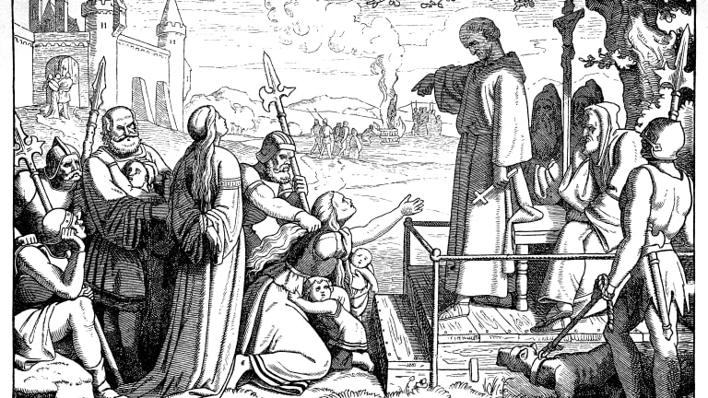
Civil Rights Investigator Training
Why don’t we listen better?
Overall Concepts:
I don’t own the Problem?
- Listen to the story/explanation from a witness point of view
- Don’t get “hooked” into the problem so that you can’t maintain a clear focus regardless of the frustrations of the witness
- Listen for vague or non-logical statements – but this is not an inquisition!
Notes:
Modifier order fixed…changes in ALL CAPS

Slide 68
Civil Rights Investigator Training
Why don’t we listen better?
So, What Should we do as Listeners?
1) Safety Environment
- Tendency to relate more to the victim, survivor, complainant
- Remember, we are not asking either party to defend themselves, just tell their story
- ”When you’re up to your ass in alligators, it’s hard to remember your job is to clear the swamp.” Anonymous
-”A good listener removes alligators and secures a setting where talkers can focus on clearing their swamps.”
Notes:
Modifier order fixed…changes in ALL CAPS

Slide 69
Civil Rights Investigator Training
Why don’t we listen better?
So, What Should we do as Listeners?
2) Acknowledge
- use words, tone, and/or body language
- ”…mmm…, I bet it is hard to be Patriots’ fan”
3) Para-Thinking
- relate back the talker’s thoughts, including their ideas, views, and observations
- in hearing, it helps them identify gaps and clarifies their recall
Notes:
Modifier order fixed…changes in ALL CAPS

Slide 70
Civil Rights Investigator Training
Why don’t we listen better?
So, What Should we do as Listeners?
4) Clarification
-strategic interruptions; get feed back
- e.g., ”I missed the importance of not taking Summer
class”
5) Decode
-”I think what I heard you say…”
-”I believe what you are saying is…”
Notes:
Modifier order fixed…changes in ALL CAPS

Slide 71
Civil Rights Investigator Training
Why don’t we listen better?
So, What Should we do as Listeners?
6) Mirror
-lean forward, backward, pace, hands on table, on
the head (but don’t go overboard, it’s not an acting class and you need to be listening and analyzing)
7) Dead Space
-create reflection; awkwardness; peace; anxiety
-to gather your own thoughts
-Witness will feel the need to fill in the space
-Don’t react to what is said…but wait…there’s
MORE…
Notes:
Modifier order fixed…changes in ALL CAPS

Slide 72
Civil Rights Investigator Training
Why don’t we listen better?
So, What Should we do as Listeners?
-Recap:
- Acknowledge Stress
-Listen – verbal, tone, body language
- try different things to remove barriers
-Empathy & support
-Listen – ask follow-up questions
-Build rapport
Notes:
Modifier order fixed…changes in ALL CAPS

Slide 73
Civil Rights Investigator Training
Conducting Interviews
Listening tips:
Listen as if you are to repeat back what was said
Don’t complete the sentences of the parties
Mirror what they said for validation: Use the exact words they used for confirmation (don’t substitute your interpretation). However, if words are vague (e.g., “I was uncomfortable”) ask for specifics.
Notes:
Modifier order fixed…changes in ALL CAPS

Slide 74
Civil Rights Investigator Training
Conducting Interviews
Listening tips:
It is important to allow the parties to speak at length since the initial conversation will often be an “information dump”
The “information dump” will often be abridged and lacking in both clarity and definition – be listening for points that require additional information (through questioning)
Pausing the conversation for clarity can be appropriate and used to confirm that you are objectively taking in their information.
Notes:
Modifier order fixed…changes in ALL CAPS

Slide 75
Civil Rights Investigator Training
Conducting Interviews
Listening tips:
Positively repeating a statement can also be helpful as it confirms to the party that you are indeed listening
Affirming a response with a nod can encourage a party to continue; however, be careful not to indicate that you agree with what they said.
If the interviewee becomes overly repetitive, redirect to issues not yet covered.
Notes:
Modifier order fixed…changes in ALL CAPS

Slide 76
Civil Rights Investigator Training
Conducting Interviews
Listening tips:
Be cognizant of indicators that you are not listening or taking a party seriously. Examples of such behaviors include:
  Distractions like cell phones, watches, and computers
  Nervous behaviors such as foot tapping, pen clicking, playing with one’s hair, etc.
  Thinking about the next question
  Making personal statements
Notes:
Modifier order fixed…changes in ALL CAPS

Slide 77
Civil Rights Investigator Training
Conducting Interviews
Questioning Skills:
ATIXA offers a helpful guide for asking questions –
1. What do I want to know?
2. Why do I want to know it? (relevance)
3. Is now the best time to ask it?
4. What is the best way to ask it? (directly or indirectly)
5. Am I the best person to ask it? (if there are two investigators)
Notes:
Modifier order fixed…changes in ALL CAPS

Slide 78
Civil Rights Investigator Training
Conducting Interviews
Begin with easy, open-ended questions to allow the party to share their perspective in a way that makes the most sense to them. Encourage people to start at the beginning of events in order to provide the fullest context (e.g., tell me what happened that night), but don’t insist on it if they want to start in the middle (or end).
Notes:
Modifier order fixed…changes in ALL CAPS

Slide 79
Civil Rights Investigator Training
Conducting Interviews
Closed-ended questions allow the investigator to gather details and specifics surrounding events, as well as to seek definitions of subjective terms used by the parties (e.g., What time did you arrive at the party? Who did you see when you walked in? What do you mean by “hooking up”?).
Notes:
Modifier order fixed…changes in ALL CAPS

Slide 80
Civil Rights Investigator Training
Conducting Interviews
A return to open-ended questions then aids the investigator in understanding factors such as effects of specified behaviors, intentions of their statements and/or acts, and to understand motivations behind a party’s decisions or actions (e.g., why did you decide to leave the party at that time?). Avoid VICTIM-BLAMING (e.g., why didn’t you just leave?)
Notes:
Modifier order fixed…changes in ALL CAPS

Slide 81
Civil Rights Investigator Training
Conducting Interviews
Questioning tips:
Set parameters, but don’t be too specific
  “We have been informed that (Respondent) may have (alleged conduct) (Complainant) (context if needed). We are interviewing anyone who may have information about this situation.”
  “What can you tell me about that night?”
Notes:
Modifier order fixed…changes in ALL CAPS

Slide 82
Civil Rights Investigator Training
Conducting Interviews
Questioning tips:
Set parameters, but don’t be too specific
  Try not to divulge statements/evidence provided by parties or other witnesses. Corroboration/refutations must be freely given. This may change, however, depending on the circumstances; if given a refutation, you may respond, e.g., “I have already talked to three other witnesses who said you were there when (the incident) happened. Why do you think they would say you were there if you were not?” (Be careful: You don’t want to imply you don’t believe them, but give them an opportunity to be more honest.)
Notes:
Modifier order fixed…changes in ALL CAPS

Slide 83
Civil Rights Investigator Training
Conducting Interviews
Questioning tips:
  Start with general, easy questions—it builds confidence and rapport
  Avoid yes/no questions
  Avoid multi-part questions
  Be patient; e.g., “Do you remember what happened next?”
Notes:
Modifier order fixed…changes in ALL CAPS

Slide 84
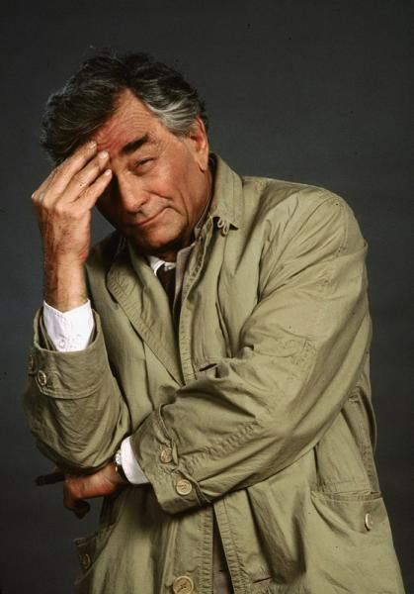
Civil Rights Investigator Training
Conducting Interviews
Questioning tips:
  Seek input in non-threatening ways
    “Help me understand……”
    “Would you be willing to show me…..”
    “So it sounds like…”
    “Tell me more about…”
    Be sincere, but don’t rule out the Columbo approach; e.g., “I’m having a hard time picturing exactly who was where at the time…..”
Notes:
Modifier order fixed…changes in ALL CAPS

Slide 85
Civil Rights Investigator Training
Conducting Interviews
Questioning tips:
  Avoid pinning down a timeline too early, but by the end of the interview, you want a chronology of events from their perspective
  Avoid “confirmation bias” by presuppositions or early impressions
  Avoid pointing out inconsistencies or apparent implausibility of accounts - save this is for your follow up interview and analysis
Notes:
Modifier order fixed…changes in ALL CAPS

Slide 86
Civil Rights Investigator Training
Conducting Interviews
Questioning tips:
  Avoid only gathering some of the information because you’re uncomfortable; use clear terminology, not euphemisms. (What exactly do you mean by “sex”?)
  Clarify terms and conditions; e.g., “drunk,” “high,” “hooked up,” “friends with benefits.”
Notes:
Modifier order fixed…changes in ALL CAPS

Slide 87
Civil Rights Investigator Training
Conducting Interviews
Questioning tips:
  Don’t allow interviewees to provide ambiguous answers or not fully answer the question (e.g., “you said you were buzzed when you got there. How much alcohol or drugs had you consumed?”)
  Avoid leading questions (e.g., “Are you saying John lied when he said that ….?)
  Feel free to seek SECO/OGC guidance for a baseline set of questions
  ALWAYS end with, “is there anything else you want to tell me or that I should know?
Notes:
Modifier order fixed…changes in ALL CAPS

Slide 88
Civil Rights Investigator Training
Conducting Interviews
Interviewing Primary Parties (Complainant and Respondent):
  Strive for equitable treatment in your interactions with the parties
  Acknowledge that a complainant may be experiencing the effect of a traumatic event, but understand that you cannot diagnose whether or not trauma is present
  Expect some minor inconsistencies (non-consequential) in stories and that parties may not tell their stories in sequence
  “Facts” can also be subjective; “how did you feel when…,” “Did you smell anything….”
Notes:
Modifier order fixed…changes in ALL CAPS

Slide 89
Civil Rights Investigator Training
Conducting Interviews
Interviewing Primary Parties (Complainant and Respondent):
  If emotional, ask if they would like to take a break
  Don’t try to “fix” their emotions; they are allowed to be angry, to cry, etc. However, try to bring them back to their story in a confirming way; e.g., “you must have been very confused at that point…what else do you remember?”
  If any party is uncooperative, remind them that it is in their best interest to ensure you have all the facts (employees MUST cooperate and be truthful)
Notes:
Modifier order fixed…changes in ALL CAPS

Slide 90
Civil Rights Investigator Training
Conducting Interviews
Interviewing Primary Parties (Complainant and Respondent):
  Don’t let them pull you into the fray; you are only a neutral fact finder
  Ask for witnesses or other corroboration of their account; e.g., “Who else might have heard you say that?” “Who did you talk to after that happened?”
  If evasive, ask questions out of sequence; a “rehearsed story” typically has to start at the beginning
  If multiple parties/witnesses tell the “exact” story, probe further for specifics they may not have rehearsed (find the “holes”)
Notes:
Modifier order fixed…changes in ALL CAPS

Slide 91
Civil Rights Investigator Training
Conducting Interviews
Interviewing Primary Parties (Complainant and Respondent):
  Don’t say:
    It’s going to be okay
    I know what you’re going through
    It could have been worse
    Questions starting with “why” – these questions often some across as accusational and judgmental and prompt defensiveness in those being questioned
Notes:
Modifier order fixed…changes in ALL CAPS

Slide 92
Civil Rights Investigator Training
Conducting Interviews
When using video/audio technology to conduct interviews (Skype, Facetime, telephones, etc.):
  Be certain to log into your account and test your equipment prior to the interview; be sure to ask the party being interviewed to do the same
  Ask any parties in the room with the party to identify themselves for the record. Any limitations that apply to the number of advisors also apply to video interviews.
  Be clear that the party being interviewed (and their advisor) are not permitted to record the interview
Notes:
Modifier order fixed…changes in ALL CAPS

Slide 93
Civil Rights Investigator Training
Case Study
Part 2
Notes:
Modifier order fixed…changes in ALL CAPS

Slide 94
Civil Rights Investigator Training
Case Study
Interview with Party A
Notes:
Modifier order fixed…changes in ALL CAPS

Slide 95
Civil Rights Investigator Training
Case Study
Process Interview (within small groups)
- How did investigators feel about the process and the questions?
- How did Cindy feel about the process and the questions?
- What did the observers note about the interview process?
We will allow five minutes for small group processing and then conduct a large group discussion.
Notes:
Modifier order fixed…changes in ALL CAPS

Slide 96
Civil Rights Investigator Training
Case Study
Large Group discussion
- How did investigators feel about the process and the questions?
- How did Cindy feel about the process and the questions?
- What did the observers note about the interview process?
Notes:
Modifier order fixed…changes in ALL CAPS

Slide 97
Civil Rights Investigator Training
Conducting Interviews
Types of Evidence – Investigators will encounter the following types of evidence:
Direct Testimony – from people involved and/or present in the event(s) being investigated
Circumstantial Evidence – physical evidence that often carries some inferences about the event(s) being investigated (intrinsically carries the same value as direct testimony)
Hearsay – helpful in identifying other sources of information
Expert – from subject matter experts who help us evaluate evidence
Character – of little to no value in determining what happened
Notes:
Modifier order fixed…changes in ALL CAPS

Slide 98
Civil Rights Investigator Training
Conducting Interviews
Sources of Information – Investigators will often seek information from the following sources:
Physical evidence (e.g., phone records, photos, text messages, audio recordings) – Caution: These may be altered!
Interviews v. written statements; do you allow interviewees to review summaries?
Computer searches – really necessary?
Social media
Corroboration by witnesses - Consider alliances; why would this person support one side or the other? This may be important in a credibility analysis.
Notes:
Modifier order fixed…changes in ALL CAPS

Slide 99
Civil Rights Investigator Training
Conducting Interviews
Impasse – At some point during the interview you may come across a roadblock or impasse where the interviewee chooses not to proceed. The following concepts can be used to overcome such situations:
Remain patient and allow the circumstance to “breathe.”
Use hypotheticals that are non-threatening and minimize perceived threats. (e.g., “if someone wanted to buy some marijuana, where do you think they would go?”)
Rephrase or revisit the line of questioning when the situation has calmed down. (e.g., “I heard you say Chris walked you to the door. Did he go outside with you?”)
Notes:
Modifier order fixed…changes in ALL CAPS

Slide 100
Civil Rights Investigator Training
Conducting Interviews
Impasse – At some point during the interview you may come across a roadblock or impasse where the interviewee chooses not to proceed. The following concepts can be used to overcome such situations:
Consider scheduling a follow up interview to give them time to decide whether or not to cooperate
Consider whether the presence of the second investigator (or you) may be discouraging the free flow of information
Notes:
Modifier order fixed…changes in ALL CAPS

Slide 101
Civil Rights Investigator Training
Conducting Interviews
Prior to concluding the initial interview, the subject should be asked for a list of relevant witnesses/documentation for consideration
Advise how the interviewee can contact you if they have further information to share
Tell them that upon collection of additional information, you may want to talk with them again
You will/will not share a summary of the interview for comments/correction (hint: you should)
Notes:
Modifier order fixed…changes in ALL CAPS

Slide 102
Civil Rights Investigator Training
Case Study
Part 3
Notes:
Modifier order fixed…changes in ALL CAPS

Slide 103
Civil Rights Investigator Training
Case Study
Interview with ???
Notes:
Modifier order fixed…changes in ALL CAPS

Slide 104
Civil Rights Investigator Training
Conducting Interviews
Follow up Interviews – In many investigations, follow up interviews of the complainant, respondent, and witnesses is a necessary step. Complainants are respondents in particular are usually interviewed two to three (or more) times during the course of an investigation, depending on the subject matter and complexity of the case.
Re-interviewing the primary parties allows the investigators to facilitate a limited form of cross-examination between the parties, proving the investigators the opportunity to share what the other party has disclosed in order to illicit a response from the party being interviewed.
Notes:
Modifier order fixed…changes in ALL CAPS

Slide 105
Civil Rights Investigator Training
Conducting Interviews
Memorializing Interviews:
Once interviews have been conducted, what do you do with the information? We recommend the following as best practice under the current A&M System Regulation 08.01.01 –
Notes:
Modifier order fixed…changes in ALL CAPS

Slide 106
Civil Rights Investigator Training
Conducting Interviews
Memorializing Interviews:
For each interview conducted, prepare a summary of the interview. You only need to include information that is related to the subject of investigation. If a witness has no relevant information, note in the report but don’t include the interview write-up.
Share the summary with the party interviewed to verify the accuracy of the information collected. Provide a short (two business day) turnaround time for responses/rebuttals.
Once the final report is prepared, destroy any personal notes/tapes from the interview
Notes:
Modifier order fixed…changes in ALL CAPS

Slide 107
Civil Rights Investigator Training
Conducting Interviews
Memorializing Interviews:
We recommend highlighting all RELEVANT material information from each summary/exhibit to ensure its inclusion in the investigative report (DO NOT copy and paste interview summaries into the Investigative Report).
Notes:
Modifier order fixed…changes in ALL CAPS

Slide 108
Civil Rights Investigator Training
Conducting Interviews
Interview Summary Example #1:
Jason and Ruby have been friends since high school. Jason was the quarterback of the football team, but he didn’t do well in academics. He always wanted to go to college at TAU since his dad and uncles went there. Jason is a sophomore majoring in history. He joined XYZ fraternity his first year. He invited Ruby to go to a bar with him on Saturday, April 12, 2019, to celebrate his 21st birthday. He said that while at the bar, he bought himself three whisky sours, and Ruby had one glass of wine. His mom called him on his cell phone while there to wish him happy birthday. He didn’t remember what time they left the bar, but they used Uber. Ruby asked him to come into her apartment for a nightcap, where she came on to him and they had consensual sex.
Notes:
Modifier order fixed…changes in ALL CAPS

Slide 109
Civil Rights Investigator Training
Conducting Interviews
Interview Summary Example #2:
Jason and Ruby have been friends since high school. He invited Ruby to go to a bar with him on Saturday, April 12, 2019, to celebrate his 21st birthday. He said that while at the bar, he bought himself three whisky sours, and Ruby had two glasses of wine. He didn’t remember what time they left, but they used Uber. Ruby asked him to come into her apartment for a nightcap. In her apartment, she unzipped his pants and gave him oral sex.
Notes:
Modifier order fixed…changes in ALL CAPS

Slide 110
Civil Rights Investigator Training
Conducting Interviews
Interview Summary Example #3 (Ruby’s account):
While Ruby liked Jason as a friend, she said she was not interested in a romantic or sexual relationship with him. She reluctantly agreed to go to a bar with him to celebrate his birthday. When they met at the bar, Jason was unsteady on his feet and slurred his words. While there, he bought himself three drinks, and his friend Amos bought him three more. Jason bought Ruby one glass of wine, and she bought herself two more over the three hours they were there (approximately 9:00 p.m. – 12:00 a.m.). Jason said he would drive her to her apartment, but she thought he was too drunk and said she would take an Uber. She didn’t know that Jason followed her in another Uber. As she opened the door to her apartment, he came up behind her and pushed her in. She said he twisted her arm and forced her to perform oral sex on him.
Notes:
Modifier order fixed…changes in ALL CAPS

Slide 111
Civil Rights Investigator Training
Case Study
Part 4
Notes:
Modifier order fixed…changes in ALL CAPS

Slide 112
Civil Rights Investigator Training
Case Study
Interview with ???
Notes:
Modifier order fixed…changes in ALL CAPS

Slide 113
Civil Rights Investigator Training
Parking Lot
Are there questions about any of the material covered so far?
Notes:
Modifier order fixed…changes in ALL CAPS

Slide 114
Civil Rights Investigator Training
Section Four
Analyzing Information
Notes:
Modifier order fixed…changes in ALL CAPS

Slide 115
Civil Rights Investigator Training
Analyzing Information
a. Standards of Evidence
b. Credibility
c. Statement Analysis
d. The Consent Construct
e. Alcohol and Other Drugs
f. Trauma
g. Predation
Notes:
Modifier order fixed…changes in ALL CAPS

Slide 116
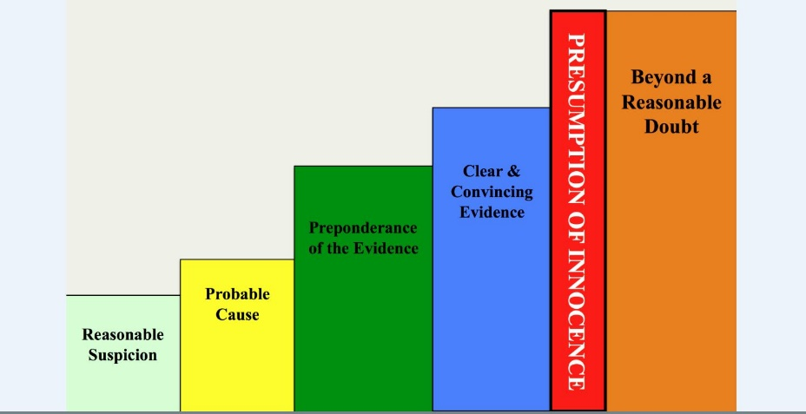
Civil Rights Investigator Training
Standards of Evidence
Notes:
Modifier order fixed…changes in ALL CAPS

Slide 117
Civil Rights Investigator Training
Standards of Evidence
Beyond a Reasonable Doubt…
Definition: No other logical explanation can be derived from the facts except that the defendant committed the crime for which they are charged, thereby overcoming the presumption that a person is innocent until proven guilty.
Statistically: 90-99% certainty
Where do we use this standard in society, and why?
Do we use this standard in our civil rights and/or ethics processes?
Notes:
Modifier order fixed…changes in ALL CAPS

Slide 118
Civil Rights Investigator Training
Standards of Evidence
Clear and Convincing…
Definition: The party must present evidence that leaves you with a firm belief or conviction that it is highly probable that the factual contentions of the claim or defense are true.
Statistically: 67-75% certainty
Where do we use this standard in society, and why?
Do we use this standard in our civil rights and/or ethics processes?
Notes:
Modifier order fixed…changes in ALL CAPS

Slide 119
Civil Rights Investigator Training
Standards of Evidence
Preponderance of the Evidence…
Definition: What is more likely than not to be true, based on probable truth or accuracy. There is neither a presumption of guilt, nor a presumption of innocence.
Statistically: 50.1% + certainty (We do not “start” at 50; we “start” at 0)
Where do we use this standard in society, and why?
Do we use this standard in our civil rights and/or ethics processes?
Notes:
Modifier order fixed…changes in ALL CAPS

Slide 120
Civil Rights Investigator Training
Standards of Evidence
Probable Cause (Substantial Evidence)…
Definition: A reasonable belief that someone may have committed an offense (crime or policy violation); this is the standard used for conducting a search, making an arrest, or filing a charge
Statistically: ~40% + certainty
Where do we use this standard in society, and why?
Do we use this standard in our civil rights and/or ethics processes?
Notes:
Modifier order fixed…changes in ALL CAPS

Slide 121
Civil Rights Investigator Training
Standards of Evidence
Reasonable Suspicion (Notice)…
Definition: Specific facts (more than a “hunch” or a “scintilla” of evidence) that justify further investigation.
Statistically: ~25% + certainty
Where do we use this standard in society, and why?
Do we use this standard in our civil rights and/or ethics processes?
Notes:
Modifier order fixed…changes in ALL CAPS

Slide 122
Civil Rights Investigator Training
Standards of Evidence
08.01.01/Student Conduct use of evidentiary standards
Notice and Gate-keeping (Reasonable Suspicion)
Bringing a charge (Substantial Evidence)
  When an allegation is deemed Substantiated?
  When an allegation is found to have Insufficient Evidence?
  When an allegation is deemed Unsubstantiated?
Finding a violation (Preponderance of the Evidence)
Determining appeals (Preponderance of the Evidence with a presumption that the original decision is correct)
Notes:
Modifier order fixed…changes in ALL CAPS

Slide 123
Civil Rights Investigator Training
Credibility
The question of credibility comes up in many investigations. How believable someone is does not just hinge on a question of truthfulness, but also of:
Bias
State of mind
Ability to recall with accuracy
Ability to pay attention to relevant details
Most parties will not lie to investigators, but their credibility can depend on any of these and more. When a party’s credibility stands out to an investigator (either positively or negatively) that is when we will see it addressed in an Investigative Report.
Notes:
Modifier order fixed…changes in ALL CAPS

Slide 124
Civil Rights Investigator Training
Credibility
Things that investigators look for that effect credibility:
Persuasiveness
Relevance
Reliability
Bias
Generally, “having no reason to lie” does not in itself establish credibility.
Notes:
Modifier order fixed…changes in ALL CAPS

Slide 125
Civil Rights Investigator Training
Persuasiveness
Things that investigators look for that effect credibility:
To be persuasive, information must:
Be believable
Be consistent (e.g., should tell essentially the same/complementary narrative over multiple tellings)
Sustain itself upon being challenged
Establish a dependable narrative that outweighs any inherent deficits (e.g., lack of complete memory as a result of time between the event and the hearing)
Notes:
Modifier order fixed…changes in ALL CAPS

Slide 126
Civil Rights Investigator Training
Persuasiveness
Persuasiveness is not about the number of witnesses supporting a particular point of view!
One persuasive witness is qualitatively better than three witnesses who are not persuasive
Notes:
Modifier order fixed…changes in ALL CAPS

Slide 127
Civil Rights Investigator Training
Relevance
To be relevant, information must:
Actually relate to the incident being reviewed
Be of sufficient value to matter in the determination of a conclusion
Be offered by an individual with actual knowledge of the event, preferably from their own involvement and/or observation
Notes:
Modifier order fixed…changes in ALL CAPS

Slide 128
Civil Rights Investigator Training
Relevance
For information to aid us in developing a conclusion, it must relate to the directly to the incident in question, and not just to incidents “like” the incident in question. We are not interested in comparing apples to oranges, nor even apples to other apples; we only have an interest in a single apple.
Notes:
Modifier order fixed…changes in ALL CAPS

Slide 129
Civil Rights Investigator Training
Reliability
To be reliable, the person providing information must:
Provide a substantively consistent telling of the story over time
Be able to have played the role they claimed to play (as participant or observer) in the event
Have appropriate training and/or experience to be able to sustain any claim of expertise
Not come from a source who can be objectively discredited
Not be countered by a party with the same or more credibility
Notes:
Modifier order fixed…changes in ALL CAPS

Slide 130
Civil Rights Investigator Training
Reliability
Reliability is objectified in a person’s honest recollections, substantively consistent memories, and the degree to which they demonstrate their training and experience, as well as the degree to which the accounts of the individual line up with other credible accounts. Reliable people recognize the limitations of their memories, training, and experience, and are honest about these limitations.
Notes:
Modifier order fixed…changes in ALL CAPS

Slide 131
Civil Rights Investigator Training
Bias
All people are biased. In providing information, it is important to own the bias that is present and to minimize its impact on the relaying of information.
For our purposes, we are concerned about three types of bias
Bias towards or against people involved in the incident by a reporter of information
Bias towards or against subject matter involved in the incident by a reporter of information
Bias brought into an investigation by an investigator
Notes:
Modifier order fixed…changes in ALL CAPS

Slide 132
Civil Rights Investigator Training
Bias
Bias towards or against people involved in the incident by a reporter of information:
What is the relationship between the reporter of information and the parties involved?
What is the relationship between the reporter of information and the institution?
While having a relationship with parties involved in an incident does not suggest that the person will be deceitful to aid or hurt the person’s case, it may well “color” the person’s recollection of the incident. Investigators can and should inquire about the strength of the relationship, and seek to ask questions about portions of the incident that people may be less likely to prepare in advance (seek “holes” in the story).
Notes:
Modifier order fixed…changes in ALL CAPS

Slide 133
Civil Rights Investigator Training
Bias
Bias towards or against subject matter involved in the incident by a reporter of information:
It is important to seek definitions on terms such as:
Always Disrespectful
Drunk “Those” people
“Hooked up” Stalking
Whenever reporters of information express strong feelings about a topic, it is important to seek to differentiate their feelings from their observations and/or involvement.
Notes:
Modifier order fixed…changes in ALL CAPS

Slide 134
Civil Rights Investigator Training
Bias
Bias brought into an investigation by an investigator:
Investigators are supposed to be “impartial”, yet there is no such thing as pure objectivity in human beings. As an investigator, it is important to be aware of the issues that serve as “hot buttons” for you, provoke emotional responses, and/or cause you to operate on perceptions and assumptions rather than evidence. Be cognizant of your bias as you begin your investigation, or in exceptional circumstances ask to be removed from the case. (continued)
Notes:
Modifier order fixed…changes in ALL CAPS

Slide 135
Civil Rights Investigator Training
Bias
Bias brought into an investigation by an investigator:
Additionally, one common short-coming of investigators is their manufacturing of possible alternatives when attempting to arrive at a conclusion. Instead of listening to the information presented and weighing it appropriately, a common temptation is to begin “supposing” about what took place by introducing facts not offered by the parties or witnesses. It is critical that investigators only utilize the information provided to them in reaching a conclusion.
When we refer to “facts in evidence,” we mean those provided by the parties, the witnesses, or by the physical evidence.
Notes:
Modifier order fixed…changes in ALL CAPS

Slide 136
Civil Rights Investigator Training
The Consent Construct (ATIXA)
Three types of sexual interactions
Wanted, consensual sex
Unwanted, consensual sex
Unwanted, nonconsensual sex
Only one of these represents a violation of regulations/rules
Notes:
Modifier order fixed…changes in ALL CAPS

Slide 137
Civil Rights Investigator Training
The Consent Construct (ATIXA)
- Force
- Incapacity
- Consent
Notes:
Modifier order fixed…changes in ALL CAPS

Slide 138
Civil Rights Investigator Training
The Consent Construct (ATIXA)
Force
Was force used by the individual to obtain sexual access?
Because consent must be voluntary (an act of free will), consent cannot be obtained through use of force.
Types of force to consider:
Physical violence: hitting, restraint, pushing, kicking, etc.
Threats: anything that gets others to do something they wouldn’t ordinarily have done absent the threat.
Notes:
Modifier order fixed…changes in ALL CAPS

Slide 139
Civil Rights Investigator Training
The Consent Construct (ATIXA)
Force
Types of force to consider (cont.)
- Intimidation: an implied threat that menaces and/or causes reasonable fear
- Coercion: the application of an unreasonable amount of pressure for sexual access
Consider:
      Frequency
      Intensity (including attempts to deprive one of choice)
      Duration
      Isolation
Notes:
Modifier order fixed…changes in ALL CAPS

Slide 140
Civil Rights Investigator Training
The Consent Construct (ATIXA)
Incapacity
Forms of incapacity?
- Alcohol or other drugs
    Incapacity ≠ Impaired, drunk, intoxicated, or under the influence
    Incapacity = an extreme form of intoxication
    Administered voluntarily or without victim’s knowledge
    Rape drugs
Mental/cognitive impairment
Injury
Asleep or unconscious
Notes:
Modifier order fixed…changes in ALL CAPS

Slide 141
Civil Rights Investigator Training
The Consent Construct (ATIXA)
Incapacity
First, was the alleged victim incapacitated at the time of sex?
Could s/he make rational, reasonable decisions?
Could s/he appreciate the situation and address it consciously such that any consent was informed?
Knowing who, what, when, where, why, and how
Second, did the accused individual know of the incapacity (fact)?
Or, should the accused individual have known from all the circumstances (reasonable person)?
Notes:
Modifier order fixed…changes in ALL CAPS

Slide 142
Civil Rights Investigator Training
The Consent Construct (ATIXA)
Incapacity
Evidence of incapacity will come from context clues, such as:
  A witness for the accused may know how much the other party consumed.
  Slurred speech
  Bloodshot eyes
  The smell of alcohol on the breath
  Shaky equilibrium
  Vomiting
  Outrageous or unusual behavior
  Unconsciousness (including blackout)
Notes:
Modifier order fixed…changes in ALL CAPS

Slide 143
Civil Rights Investigator Training
The Consent Construct (ATIXA)
Consent
Consent is…
- Informed, knowing, and voluntary (freely given),
- Active (not passive),
- Affirmative action through clear words or actions,
- That create mutually understandable permission regarding the conditions of sexual activity.
- Cannot be obtained by use of:
- Physical force, compelling threats, intimidating behavior, or coercion.
- Cannot be given by someone known to be — or who should be known to be — mentally or physically incapacitated.
Notes:
Modifier order fixed…changes in ALL CAPS

Slide 144
Civil Rights Investigator Training
The Consent Construct (ATIXA)
Consent
Lack of protest or resistance ≠ consent
Consent should not be assumed
Must be present through the entire incident; consent can be withdrawn at any time
The inability to give consent may be a result of, but not limited to, the following individuals:
  Persons who are asleep or unconscious.
  Persons who are incapacitated due to the influence of drugs, alcohol, or medication.
  Persons who are unable to communicate consent due to a mental or physical condition, including minors.
Notes:
Modifier order fixed…changes in ALL CAPS

Slide 145
Civil Rights Investigator Training
The Consent Construct (ATIXA)
Consent (as defined in 08.01.01)
Clear, voluntary and ongoing agreement to engage in a specific sexual act. Persons need not verbalize their consent to engage in a specific sexual act for there to be permission. Permission to engage in a sexual act may be indicated through physical actions rather than words. A person who was asleep or mentally or physically incapacitated, either through the effect of drugs or alcohol or for any other reason, or whose agreement was made under duress or by threat, coercion, or force, cannot give consent.
Notes:
Modifier order fixed…changes in ALL CAPS

Slide 146
Civil Rights Investigator Training
The Consent Construct (ATIXA)
Consent complications
Lack of relationships and understood norms of behavior
Past interactions with one another that may be transposed onto the current encounter
Past interactions with others that get transposed onto a new partner
Influence of alcohol and/or drugs
Alternative Lifestyles and Power Exchanges (Kink, BDSM, con noncon, etc.)
  Useful resource for investigators: https://www.urbandictionary.com/)
Notes:
Modifier order fixed…changes in ALL CAPS

Slide 147
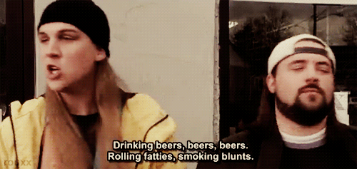
Civil Rights Investigator Training
Alcohol and Other Drugs
Notes:
Modifier order fixed…changes in ALL CAPS

Slide 148
Civil Rights Investigator Training
Alcohol and Other Drugs
Can two adults who are both “drunk” engage in consensual sex with one another?
Notes:
Modifier order fixed…changes in ALL CAPS

Slide 149
Civil Rights Investigator Training
Alcohol and Other Drugs
Can two adults who are both “drunk” engage in consensual sex with one another?
YES – our standard for lack of consent is not “drunk” (otherwise defined as inebriated), but incapacitated.
To be incapacitated means to be physically helpless and/or be mentally incapable of making a decision and appreciating the consequences of one’s choices.
Notes:
Modifier order fixed…changes in ALL CAPS

Slide 150
Civil Rights Investigator Training
Alcohol and Other Drugs
Tolerance
What is a drink? (niaa.nih.gov)
12 oz. of beer (5% alcohol)
5 oz. of wine (12% alcohol)
1.5 oz. distilled spirits (40% alcohol)
Metabolism
The “I” Words
Influence
Impairment
Inebriation/Intoxication (drunk)
Incapacitation
Notes:
Modifier order fixed…changes in ALL CAPS

Slide 151
Civil Rights Investigator Training
Alcohol and Other Drugs
Factors that effect capacity
sex age
body mass tolerance
illness menstrual cycle stomach contents method of drinking
water consumption duration of drinking
type of alcohol consumed carbonation
amount of alcohol consumed
prescription and non-prescription medications
Notes:
Modifier order fixed…changes in ALL CAPS

Slide 152
Civil Rights Investigator Training
Alcohol and Other Drugs
Passing out vs. Blacking out
Investigators:
- Estimate blood alcohol level based on information available
- Compare this to the reported/observed behaviors
- Are these consistent with one another?
- Are these indicative of a lack of capacity to consent?
What about?
- Mutual Incapacity
- Known or reasonably should have known…
Notes:
Modifier order fixed…changes in ALL CAPS

Slide 153
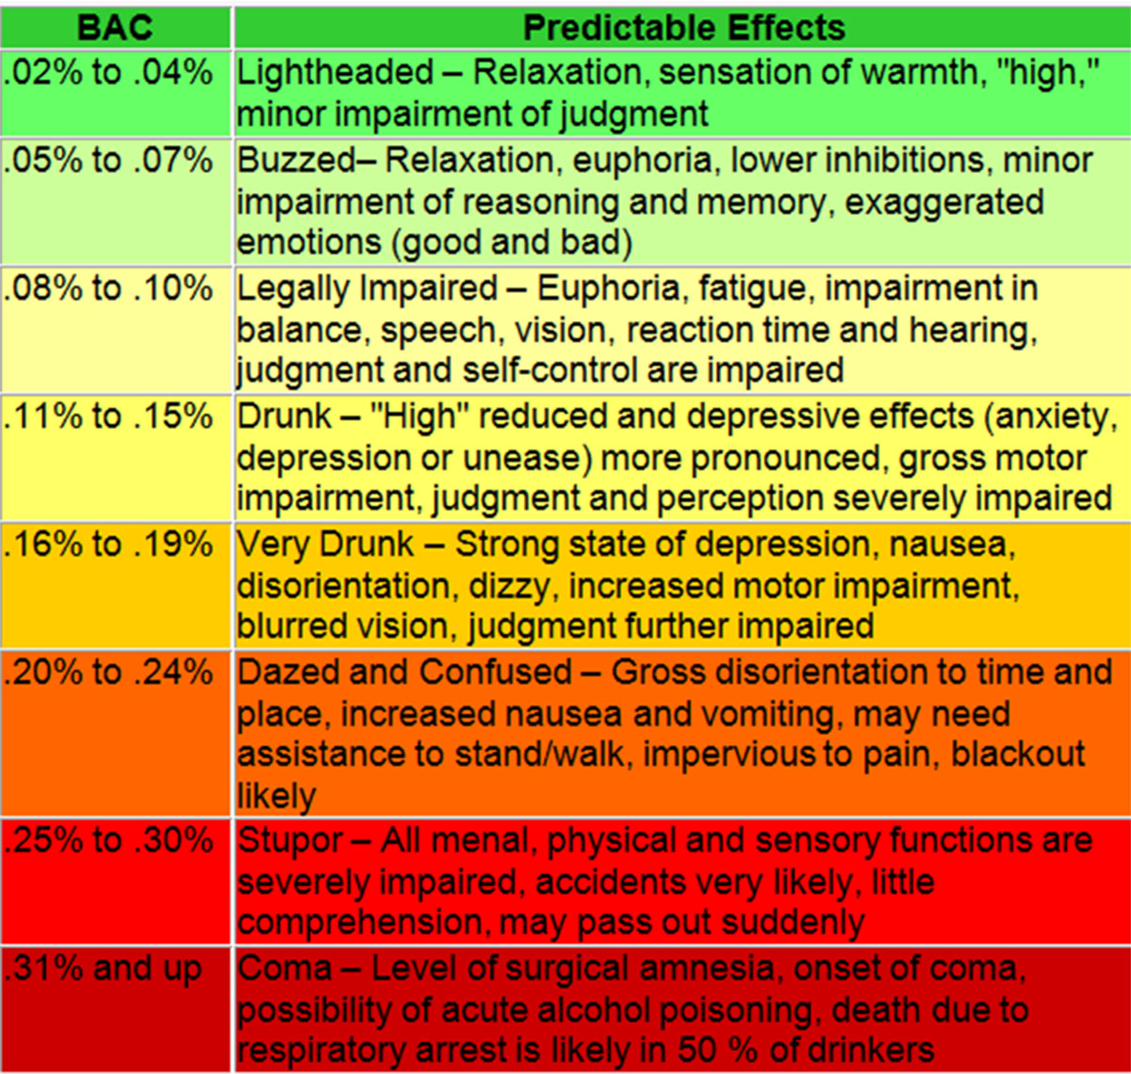
Civil Rights Investigator Training
Alcohol and Other Drugs
http://www.uwec.edu/CASE/students/moderation.htm
Notes:
Modifier order fixed…changes in ALL CAPS

Slide 154
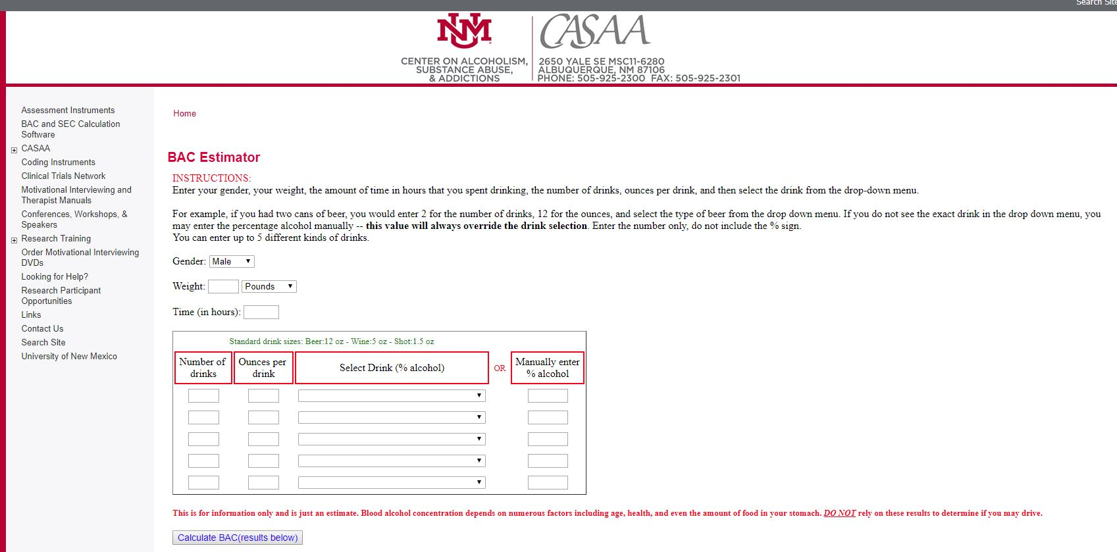
Civil Rights Investigator Training
Alcohol and Other Drugs
https://casaa.unm.edu/BACcalc.html
Notes:
Modifier order fixed…changes in ALL CAPS

Slide 155
Civil Rights Investigator Training
Alcohol and Other Drugs
Other (illicit) drugs:
- By design, other drugs (illicit, non-prescription) are designed to impair normal bodily functions
- The quality control of drugs is difficult to account for; illicit drugs can be tainted with other drugs that significantly effect the experience of being “high” (note that “high” does not automatically indicate incapacity)
- When used with alcohol, the effects of drugs are cumulative to the effects of alcohol
Notes:
Modifier order fixed…changes in ALL CAPS

Slide 156
Civil Rights Investigator Training
Trauma
What is Trauma?
Trauma is exposure to an event or events that creates a real or perceived threat to life, safety, or sense of well being and bodily integrity.
Trauma results from war, natural disasters, physical violence (non-sexual and sexual), relationship violence, stalking, and child abuse. Trauma is different than stress in how it activates certain parts of the brain and shuts down others.
Notes:
Modifier order fixed…changes in ALL CAPS

Slide 157
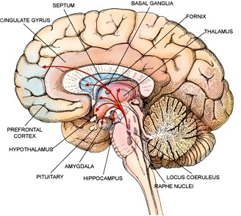
Civil Rights Investigator Training
Trauma
The Brain:
Cortex (thinking)
Limbic (emotions)
Brain Stem (survival)
The Brain and Trauma (activated):
Hypothalamus
Pituitary
Hippocampus
Amygdala
Notes:
Modifier order fixed…changes in ALL CAPS

Slide 158

Civil Rights Investigator Training
Trauma
“Alligator Brain” controls:
Fight (approach)
Flight (avoidance)
Freeze (submission)
Notes:
Modifier order fixed…changes in ALL CAPS

Slide 159

Civil Rights Investigator Training
Trauma
Trauma triggers:
Fight, Flight, Freeze response (not a choice)
Incapacitation of frontal lobe through the release
of a hormonal flood, which can last for up to 4 days
and may be reactivated by a triggering event
Up to half of those experiencing a sexual assault
experience a tonic immobility which is described as a paralysis – this is a biological response
Hippocampus (Memory Maker) can still accept sensory data and encode it, but cannot consolidate memories and store (think of a card catalog); memory recall tends to be fragmented and recall can be slow and difficult
Notes:
Modifier order fixed…changes in ALL CAPS

Slide 160
Civil Rights Investigator Training
Trauma
Trauma and Investigations
Don’t diagnose whether or not trauma exists; respect that it may exist
Expect a non-linear account; the important issue is whether or not the accumulation of stories is coherent and consistent and not contradictory
Use open-ended questions and be patient in allowing for responses; don’t bombard someone with multiple questions or multi-part questions
Allow time
Never impose your expected reactions to an event on to someone else; how people react in a traumatic situation (and following it) may seem counter-intuitive
Use non-judgmental and non-blaming language; avoid “Why” questions
Emphasize transparency and predictability
Notes:
Modifier order fixed…changes in ALL CAPS

Slide 161
Civil Rights Investigator Training
Predation
Definition of Predation (08.01.01)
Predation – an intent to engage in these acts prior to their occurrence demonstrating premeditation, planning or forethought, and is reflected in communicated intent (verbal, visual, or written), threats directed at a party, attempts to incapacitate a party, attempts to isolate a party, utilizing violence, or other actions that a reasonable person would construe as a pre-meditation to engage in unwanted actions. Committing any of these actions with an individual under the age of consent is also considered predatory.
Notes:
Modifier order fixed…changes in ALL CAPS

Slide 162
Civil Rights Investigator Training
Predation
Considerations
Influence (cajoling, pressuring, etc.)
Isolation
Substances
Coercion and/or Threats
Violence
Collaboration
Notes:
Modifier order fixed…changes in ALL CAPS

Slide 163
Civil Rights Investigator Training
Case Study
Part 5
Notes:
Modifier order fixed…changes in ALL CAPS

Slide 164
Civil Rights Investigator Training
Case Study
Supplemental Interviews
- Determine if investigators need to conduct additional interviews of any parties (may conduct multiple interviews)
- Skip the greetings and opening statement
- Observers should again play the roles of the witnesses when needed
- No small or large group processing for witness interviews
Notes:
Modifier order fixed…changes in ALL CAPS

Slide 165
Civil Rights Investigator Training
Parking Lot
Are there questions about any of the material covered so far?
Notes:
Modifier order fixed…changes in ALL CAPS

Slide 166
Civil Rights Investigator Training
Section Five
Developing a Report
Notes:
Modifier order fixed…changes in ALL CAPS

Slide 167
Civil Rights Investigator Training
Developing a Report
Preparing an Investigative Report:
Follow the template provided by SECO for investigative reports
Clearly outline the specific allegations (focus on the specific behavior and not 08.01.01 language)
Example: “Did John refer to Ahmad as derogatory terms such as “raghead” and “terrorist”?
NOT: “Did John harass Ahmad based on race or national origin? (this comes later)
Notes:
Modifier order fixed…changes in ALL CAPS

Slide 168
Civil Rights Investigator Training
Developing a Report
Preparing an Investigative Report:
State the applicable regulation/rule (note: cases involving student respondents should not reference the code of student conduct)
Organize by event in chronological order. Start with the complainant’s rendition. You may follow with the Respondent’s or supporting witnesses. Respondent’s rendition can be followed by witnesses supporting that side. Then move to the next event/incident/allegation.
Notes:
Modifier order fixed…changes in ALL CAPS

Slide 169
Civil Rights Investigator Training
Developing a Report
Life Cycle of a Report:
Initial Draft Report (IDR)
This report is submitted by the investigators to the person who assigned them. This person is responsible for vetting the report (for initial quality control) prior to sending it to OGC and SECO for review – no one else is to see this draft of the report.
The initial draft report should only include information that is material (relevant) to the allegations and must account for all inculpatory and exculpatory evidence.
Notes:
Modifier order fixed…changes in ALL CAPS

Slide 170
Civil Rights Investigator Training
Developing a Report
Life Cycle of a Report:
Initial Draft Report (IDR)
- For each allegation, the report should state what the complainant alleged, what the respondent said, then what the witnesses said. Thereafter should follow an analysis and conclusion as to whether or not the evidence substantiates the alleged conduct. Then move to the next specific allegation. Don’t group everything each party/witness said about all the allegations together, as this makes the analysis difficult and confusing.
- After all allegations have been addressed, insert an analysis of whether or not a policy/regulation/conduct rule was violated, followed by the conclusion (as seen in the report template).
Notes:
Modifier order fixed…changes in ALL CAPS

Slide 171
Civil Rights Investigator Training
Developing a Report
Life Cycle of a Report:
OGC/SECO Review
OGC and SECO review the IDR for the purposes of sufficiency (are the conclusions supported by the facts of the case) and investigative method (appropriate parties interviewed, appropriate interpretation of evidence, etc.).
Notes:
Modifier order fixed…changes in ALL CAPS

Slide 172
Civil Rights Investigator Training
Developing a Report
Life Cycle of a Report:
Final Draft Report (FDR)
A revised report is created based on feedback provided through the OGC/SECO review. This report (provided it does not require additional OGC/SECO review) is then given to the primary parties for review and comment.
Notes:
Modifier order fixed…changes in ALL CAPS

Slide 173
Civil Rights Investigator Training
Developing a Report
Life Cycle of a Report:
Comment Period (Best Practice, not currently required in 08.01.01)
OGC and SECO review the IDR for the purposes of sufficiency (is the conclusions supported by the facts of the case) and investigative method (appropriate parties interviewed, appropriate interpretation of evidence, etc.). The parties are provided a brief (2-5 business days, based on length of the report) period to offer feedback on the report. The feedback is to be considered by the investigators and identified in the Final Report, but the investigators will generally defer to the own recollections of the interviews and their own interpretation of the evidence. If any substantive changes are made, the report should be resubmitted to OGC/SECO for additional review.
Notes:
Modifier order fixed…changes in ALL CAPS

Slide 174
Civil Rights Investigator Training
Developing a Report
Life Cycle of a Report:
Final Report (FR)
A final report is prepared and submitted to the person who assigned the investigators, who then forwards the report to the appropriate administrator/panel. Further distribution of the report comes from the appropriate adjudicatory process (Designated Administrator, panel, etc.)
Notes:
Modifier order fixed…changes in ALL CAPS

Slide 175
Civil Rights Investigator Training
Developing a Report
Three key questions –
There are three key (and separate) analytical components of any investigation:
Did the alleged behavior occur?
Did the behavior occur because of a protected class?
If “yes,” does the behavior constitute a violation of the cited regulation/rule? (individually or collectively)
Notes:
Modifier order fixed…changes in ALL CAPS

Slide 176
Civil Rights Investigator Training
Developing a Report
When examining whether or not substantiated behavior violates 08.01.01 and the case is not “quid pro quo” harassment, the investigator must apply the mechanics of the “hostile environment” standard IF it is concluded that the behavior was based on a protected category (sex, race, national origin, etc.).
Notes:
Modifier order fixed…changes in ALL CAPS

Slide 177
Civil Rights Investigator Training
Developing a Report
When examining whether or not substantiated behavior violates 08.01.01 and the case is not “quid pro quo” harassment, the investigator must apply the mechanics of the “hostile environment” standard
Is the behavior severe (creates a work, educational, or campus living environment that a reasonable person would consider intimidating or abusive)?
OR
Notes:
Modifier order fixed…changes in ALL CAPS

Slide 178
Civil Rights Investigator Training
Developing a Report
When examining whether or not substantiated behavior violates 08.01.01 and the case is not “quid pro quo” harassment, the investigator must apply the mechanics of the “hostile environment” standard
Is the behavior persistent (has occurred more than once and/or has happened with unreasonable frequency)?
OR
Notes:
Modifier order fixed…changes in ALL CAPS

Slide 179
Civil Rights Investigator Training
Developing a Report
When examining whether or not substantiated behavior violates 08.01.01 and the case is not “quid pro quo” harassment, the investigator must apply the mechanics of the “hostile environment” standard
Is the behavior pervasive (the respondent is engaging in the behavior with other people and/or the climate has been negatively effected by the behavior)?
AND
Notes:
Modifier order fixed…changes in ALL CAPS

Slide 180
Civil Rights Investigator Training
Developing a Report
When examining whether or not substantiated behavior violates 08.01.01 and the case is not “quid pro quo” harassment, the investigator must apply the mechanics of the “hostile environment” standard
Is the behavior intimidating or abusive to a reasonable person?
Let’s look at our investigative report template…
Notes:
Modifier order fixed…changes in ALL CAPS

Slide 181
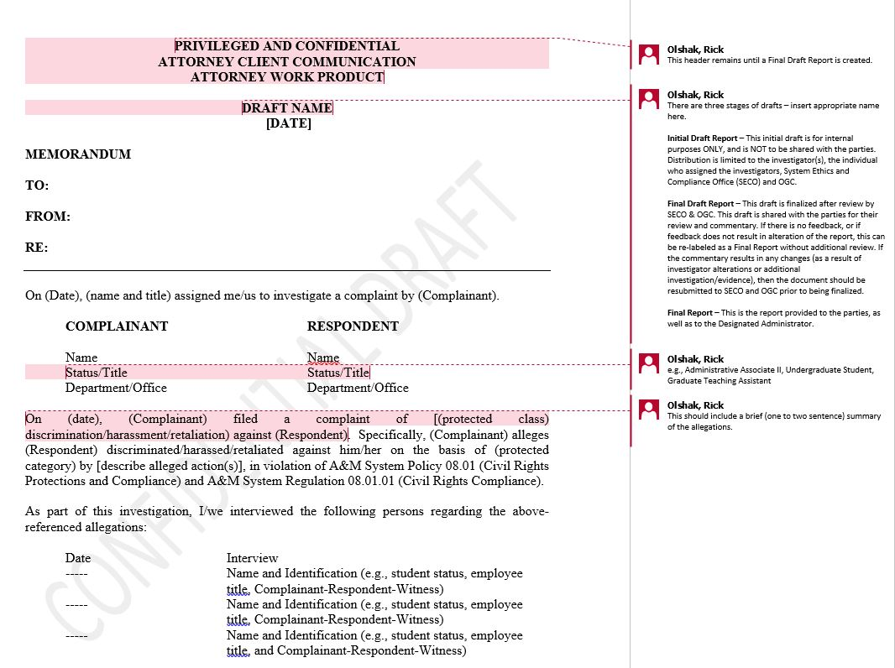
Civil Rights Investigator Training
Notes:
Modifier order fixed…changes in ALL CAPS

Slide 182
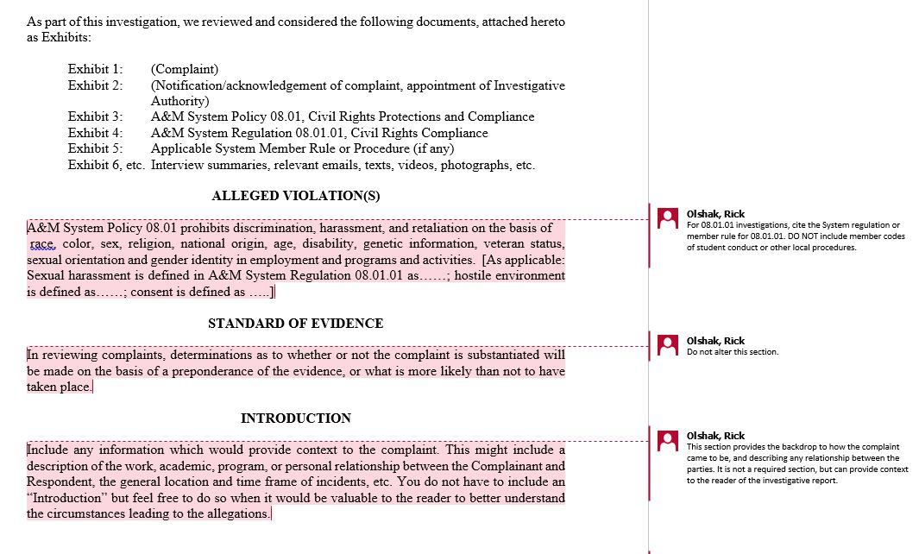
Civil Rights Investigator Training
Notes:
Modifier order fixed…changes in ALL CAPS

Slide 183
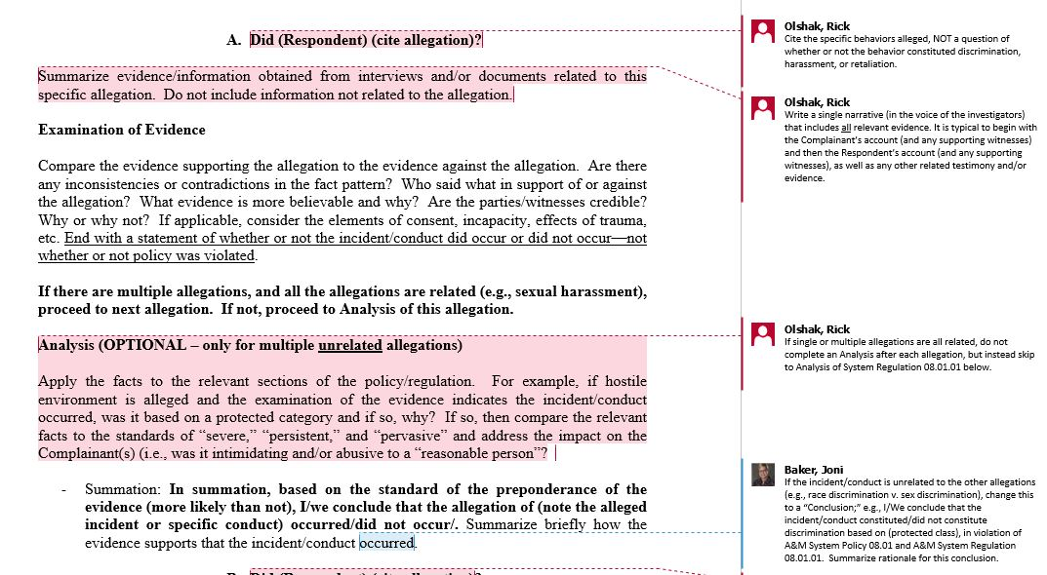
Civil Rights Investigator Training
Notes:
Modifier order fixed…changes in ALL CAPS

Slide 184
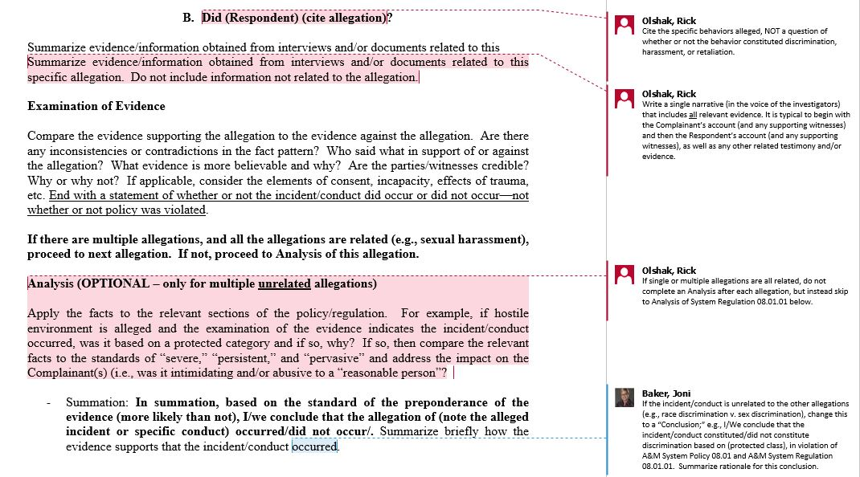
Civil Rights Investigator Training
Notes:
Modifier order fixed…changes in ALL CAPS

Slide 185
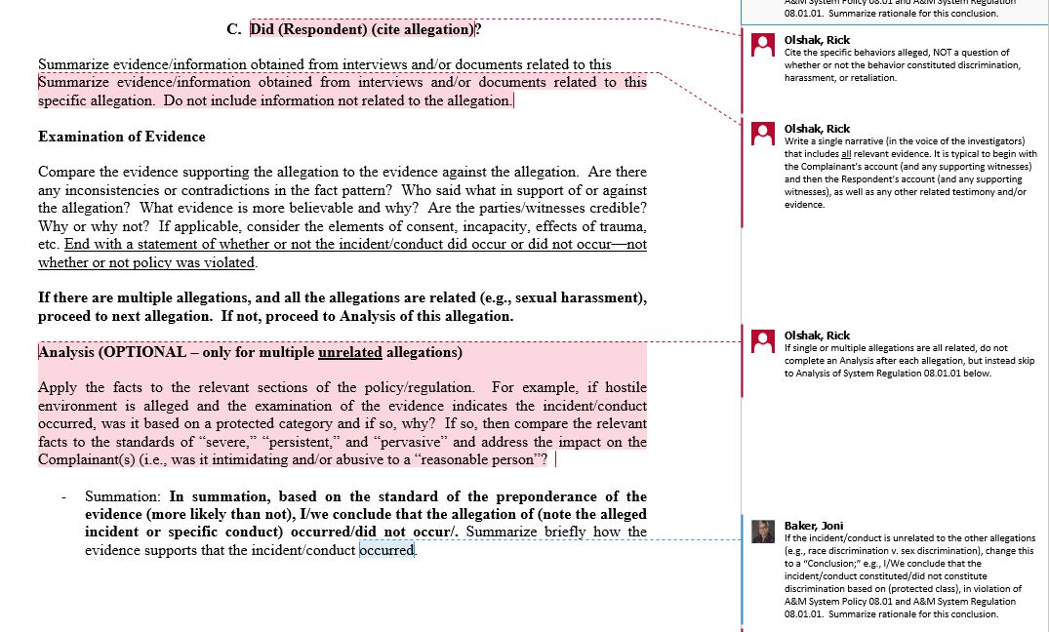
Civil Rights Investigator Training
Notes:
Modifier order fixed…changes in ALL CAPS

Slide 186
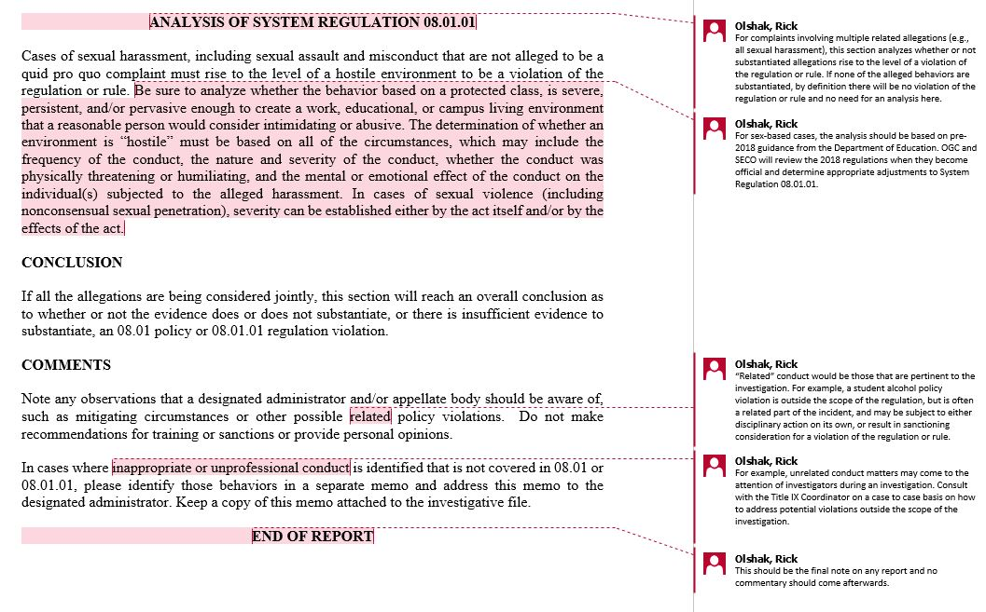
Civil Rights Investigator Training
Notes:
Modifier order fixed…changes in ALL CAPS

Slide 187
Civil Rights Investigator Training
Case Study
Part 6
Notes:
Modifier order fixed…changes in ALL CAPS

Slide 188
Civil Rights Investigator Training
Case Study
Developing a Report/Reaching Conclusions
- Each group of investigators will answer the following questions:
  Question A: Did Rob engage in sex with Cindy without her consent?
  Question B: Did Rob send unwanted text messages to Cindy? If so, does this constitute sexual harassment?
  Question C: Did Rob send unwanted gifts to Cindy? If so, does this constitute sexual harassment?
- The investigators may be aided by the observers, but may not be aided by those playing Cindy or Rob
Notes:
Modifier order fixed…changes in ALL CAPS

Slide 189
Civil Rights Investigator Training
Case Study
Developing a Report/Reaching Conclusions
If the conclusion to any of the allegations is affirmative (i.e., substantiated) then the investigators must examine if the behavior violates A&M System Regulation 08.01.01 on the basis of hostile environment.
Three key definitions:
  Sexual Harassment
  Consent
  Hostile Environment
Notes:
Modifier order fixed…changes in ALL CAPS

Slide 190
Civil Rights Investigator Training
Case Study
Sexual Harassment (A&M System Regulation 08.01.01)
– a form of sex discrimination. Unwelcome sexual advances, requests for sexual favors or other verbal, nonverbal or physical conduct of a sexual nature constitute sexual harassment when this conduct is so severe, persistent or pervasive that it explicitly or implicitly affects an individual's employment, unreasonably interferes with an individual's work or educational performance, or creates an intimidating or hostile work, educational, or campus living environment. Unwelcome means that an individual did not request or invite it and considers the conduct to be undesirable or offensive. Submission to the conduct or failure to complain does not always mean that the conduct was welcome. Sexual harassment may be quid pro quo (“this for that”) or may constitute a hostile environment. Sexual harassment includes non-consensual sexual contact, sexual assault, sexual exploitation, stalking, dating violence, and domestic violence when based on sex.
Notes:
Modifier order fixed…changes in ALL CAPS

Slide 191
Civil Rights Investigator Training
Case Study
Consent (A&M System Regulation 08.01.01)
– clear, voluntary and ongoing agreement to engage in a specific sexual act. Persons need not verbalize their consent to engage in a sexual act for there to be permission. Permission to engage in a sexual act may be indicated through physical actions rather than words. A person who was asleep or mentally or physically incapacitated, either through the effect of drugs or alcohol or for any other reason, or whose agreement was made under duress or by threat, coercion, or force, cannot give consent.
Notes:
Modifier order fixed…changes in ALL CAPS

Slide 192
Civil Rights Investigator Training
Case Study
Hostile Environment (A&M System Regulation 08.01.01)
– a situation in which there is harassing conduct based on a legally protected
class that is severe, persistent, or pervasive enough to create a work, educational, or campus living environment that a reasonable person would consider intimidating or abusive. The determination of whether an environment is “hostile” must be based on all of the circumstances, which may include the frequency of the conduct, the nature and severity of the conduct, whether the conduct was physically threatening or humiliating, and the mental or emotional effect of the conduct on the individual(s) subjected to the alleged harassment.
Notes:
Modifier order fixed…changes in ALL CAPS

Slide 193
Civil Rights Investigator Training
Case Study
Developing a Report/Reaching Conclusions
Once the investigators have reached their conclusions, they will prepare a brief outline of their conclusions that mirrors the format of the reporting template (use bullet points instead of paragraphs)
Each group will report its conclusions
The training staff will then present their analysis of the scenario
Notes:
Modifier order fixed…changes in ALL CAPS

Slide 194
Civil Rights Investigator Training
Case Study
Group Reporting (Groups 1 through 6)
- Please report in a maximum of 3-5 minutes
Notes:
Modifier order fixed…changes in ALL CAPS

Slide 195
Civil Rights Investigator Training
Case Study
Training Staff Analysis
  Question A: Did Rob engage in sex with Cindy without her consent?
  NO. Both Rob and Cindy maintained their capacity to consent to sexual activity. While Cindy demonstrated some desire to go to sleep and end the evening, she did agree to provide oral sex to Rob and did so at her own initiation. Whether or not the sex was desired, it was consented to.
Notes:
Modifier order fixed…changes in ALL CAPS

Slide 196
Civil Rights Investigator Training
Case Study
Training Staff Analysis
  Question A: Did Rob engage in sex with Cindy without her consent?
  “Cheat Sheet” for Capacity (Cindy):
  Assuming a 130 pound female –
  3 hard lemonades over three hours: 0.096 BAL (at its highest)
  (Total Standard drinks: 4.16)
  Plus one bite of marijuana brownie
  (50 mg dosage brownie – ten bites worth) - 5 mg consumed
  5 mg considered a low dose with moderate effect over a 2-5 hour period of time
  With the fact pattern and this estimate of substance use, incapacity is possible but unlikely.
Notes:
Modifier order fixed…changes in ALL CAPS

Slide 197
Civil Rights Investigator Training
Case Study
Training Staff Analysis
  Question A: Did Rob engage in sex with Cindy without her consent?
  “Cheat Sheet” for Capacity (Rob):
  Assuming a 170 pound male –
  4 hard lemonades over 4 hours: 0.058 BAL (at its highest)
  (Total Standard drinks: 5.547)
  Plus three bites of a marijuana brownie
  (50 mg dosage brownie – ten bites worth) - 15 mg consumed
  15 mg considered a moderate dose with moderate effect over a 2-5 hour period of time
  With the fact pattern and this estimate of substance use, incapacity is possible but unlikely.
Notes:
Modifier order fixed…changes in ALL CAPS

Slide 198
Civil Rights Investigator Training
Case Study
Training Staff Analysis
  Question B: Did Rob send unwanted text messages to Cindy? If so, does this constitute sexual harassment?
  NO. While Cindy may have been annoyed with the frequency of messages, at no time did she indicate to Rob that he should stop messaging her. Her initiation of some of the exchanges, even for the sake being nice, provided Rob a reasonable belief that his messages were welcome.
Notes:
Modifier order fixed…changes in ALL CAPS

Slide 199
Civil Rights Investigator Training
Case Study
Training Staff Analysis
  Question C: Did Rob send unwanted gifts to Cindy? If so, does this constitute sexual harassment?
  NO. While Cindy was embarrassed by the flower delivery and told Rob that he should not have bought the gifts, at no time did Cindy as Rob to stop sending gifts. Given their different expectations and understandings of what constituted their relationship, Cindy’s annoyance can be understood, but this does not rise to the level of a violation of the Regulation (it is not severe, persistent, or pervasive). Rather, this is an example of poorly communicated expectations on the part of both Cindy and Rob.
Notes:
Modifier order fixed…changes in ALL CAPS

Slide 200
Civil Rights Investigator Training
Parking Lot
Are there remaining questions about any of the material covered over these two days?
Notes:
Modifier order fixed…changes in ALL CAPS

Slide 201

Civil Rights Investigator Training
Housekeeping (3 items)
If you have any questions after the conclusion of this program, please contact Rick Olshak at rolshak@tamus.edu.
Certificates of completion for this training program will be mailed to your university/agency in the next 3-4 weeks
Notes:
Modifier order fixed…changes in ALL CAPS

Slide 202
Civil Rights Investigator Training
Housekeeping (3 items)
Finally, we ask each of you to please complete an online evaluation of this program. The evaluation can be found at https://www.surveymonkey.com/r/TAMUSJuly19 and will be available online for the next seven days (through next Wednesday). Thank you in advance for your assistance in improving the quality of this program.
Thank you for your participation!
Notes:
Modifier order fixed…changes in ALL CAPS

